Slide 1
Interpolating polynomials

Slide 2
Introduction
In this topic, we will
See how to find interpolating linear and quadratic polynomials
Learn about the Vandermonde matrix and see how to interpolate n points with a polynomial of degree n – 1
Review why it is necessary to use partial pivoting when solving systems of linear equations
See how to decrease the error by shifting x-values before finding the interpolating polynomial
Look at implementations of functions for finding interpolating quadratic polynomials in both C++ and Matlab

Slide 3
Linear interpolation
Given two points (x₁, y₁), (x₂, y₂) with x₁ ≠ x₂, you can find the straight line that passes through these two points
In secondary school, you likely found a line y = mx + b as follows:
Subtract Equation 1 from Equation 2 to get
Isolate m
And substitute m back in and solve for b:

Slide 4
Linear interpolation
What you may have noticed by now is that this is a system of two linear equations in two unknowns:
Recall that it is mx₁ + b·1 = y₁ and mx₂ + b·1 = y₂
Interpolate (1.5, 7.2) and (3.3, 10.8)
In Matlab, we would do the following:
>> a = [1.5 1; 3.3 1] \ [7.2 10.8]'
ans =
2.0000
4.2000

Slide 5
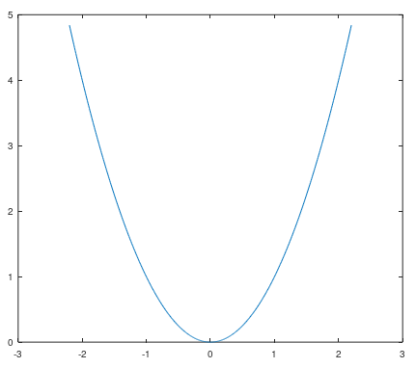
Quadratic interpolation
Given three points (x₁, y₁), (x₂, y₂), (x₃, y₃) with all three x values being different, can you find a straight line passing through them?
Of course not; for example (–1, 1), (1, 1), (2, 4)
The straight line y = 1 passes through the first two points, but not through the third
There is, however, a quadratic that passes through these three points:
y = x²

Slide 6
Quadratic interpolation
Given three points (x₁, y₁), (x₂, y₂), (x₃, y₃) with all three x values being different, can you find a quadratic passing through them?
Suppose the quadratic is of the form ax² + bx + c
This is a system of three linear equations in three unknowns:

Slide 7
Quadratic interpolation
From here on in this course, we always write down an unknown polynomial as a₂ x² + a₁ x + a₀
The subscript of the coefficient equals the exponent of the term
Thus, our previous problem would be to solve:

Slide 8
Linear algebra
Does this system of three equations and three unknowns have a unique solution?
We can calculate the determinant:
As long as all three x values are different, the determinant is non-zero
If any two x-values are equal, the determinant is zero

Slide 9
Quadratic interpolation
Let us do an example:
Find the interpolating quadratic polynomial passing through
(0.4, 3.12), (1.2, 3.28), (3.5, 18)
We must solve
In Matlab, we would do the following:
>> V = [0.4^2 0.4 1 1.2^2 1.2 1
3.5^2 3.5 1];
>> a = V \ [3.12 3.28 18.0]'
a =
2
-3
4

Slide 10
Quadratic interpolation
Writing down these matrices in Matlab can be error prone
The vander function in Matlab generates this matrix
>> V = [0.4^2 0.4 1
1.2^2 1.2 1
3.5^2 3.5 1]
V =
0.1600 0.4000 1.0000
1.4400 1.2000 1.0000
12.2500 3.5000 1.0000
>> V = vander( [0.4 1.2 3.5] )
V =
0.1600 0.4000 1.0000
1.4400 1.2000 1.0000
12.2500 3.5000 1.0000
This matrix is called the Vandermonde matrix

Slide 11
Quadratic interpolation
Remember, however, just because the determinant is non-zero does not mean we can find the solution numerically
Suppose the three points were 0, 0.001 and 100:
>> V = vander( [0 0.001 100]' )
0 0 1
0.000001 0.001 1
10000 100 1
>> det( V )
-9.9999
>> cond( V )
14143693.10488148

Slide 12
Quadratic interpolation
Equally spaced numbers result in a smaller condition number:
>> cond( vander( [0 1 2] ) )
13.9125
>> cond( vander( [0 0.9 2] ) )
14.0740
>> cond( vander( [0 1.1 2] ) )
14.0770
>> cond( vander( [-1 0 1] ) )
3.2255
Fortunately, most engineering data comes from periodically sampled sensors, so sampled data will, in general, see have x-values that are equally spaced
Actually, they will usually be t-values as they are samples in time
You don’t have to know why or prove that equally-spaced
points result in smaller condition numbers

Slide 13
General interpolation
Theorem
Given n points (x₁, y₁), …, (x_{n}, y_{n}) with all x-values being distinct, there exists a unique polynomial
a_{n–1}x^{n–1} + a_{n–2}x^{n–2} + ··· + a₂x² + a₁x + a₀
of degree n – 1 that passes through all n points.
Proof:
The proof is constructive.
The system of linear equations is as follows:

Slide 14
General interpolation
Now, normally, one cannot use the determinant to determine numerically if a matrix is invertible
However, with an algebraic matrix, it is possible to use induction to deduce that the determinant of the matrix is
That is, it is the product of all pairwise differences of the x values.
If all x values are different, all differences are non-zero
Thus the determinant is non-zero, and thus a unique solution exists. ▮
You only need to be aware of the theorem; you don’t need to know the proof.

Slide 15
General interpolation
Once again, having n points where the x-values are equally spaced tends to have smaller condition numbers
Equally spaced x-values are not actually ideal, but the ideal points are beyond the scope of this point
Also, as mentioned before, these points tend to come from a sensor being periodically sampled
For example:
>> cond( vander( [1 2 3 4] ) )
1171.0
>> cond( vander( [1 1.1 3.9 4] ) )
4932.3
>> cond( vander( [-1.5 -0.5 0.5 1.5] ) )
9.1617
>> cond( vander( [-1.5 -0.80233 0.80233 1.5] ) )
7.3919

Slide 16
Numeric error
In the previous example, we discussed how failing to account for floating-point arithmetic may lead to errors in finding solutions to systems of linear equations
Suppose we want to interpolate the points
(0.00001532, 4.545), (2.523, 5.237)
We must therefore solve
Using our six-digit floating-point representation
Without partial pivoting, the solution is y = 4.545
With partial pivoting, the solution is y = 0.2743x + 4.545

Slide 17
Numeric error
You may ask why anyone would interpolate
(0.00001532, 4.545), (2.523, 5.237)
instead of
(0.0, 4.545), (2.523, 5.237)
Consider this program:
#include <iostream>
int main();
int main() {
std::cout.precision( 16 );
for ( double x{-1.0}; x < 0.05; x += 0.1 ) {
std::cout << x << std::endl;
}
return 0;
}
Output:
-1
-0.9
-0.8
-0.7000000000000001
-0.6000000000000001
-0.5000000000000001
-0.4000000000000001
-0.3000000000000002
-0.2000000000000001
-0.1000000000000001
-1.387778780781446e-16
This is for information purposes only
- This is not on the examination

Slide 18
Numeric error
We can even see the issues in Matlab:
>> small = 2^-53 + 2^-55
small = 1.387778780781446e-16
>> a = [small 1; 2.523 1] \ [4.545 5.237]'
a =
0.27428
4.54500
>> A = [small 1 4.545; 2.523 1 5.237];
A =
-1.3878e-16 1 4.5450
2.5230 1 5.2370
>> A(2,:) = A(2,:) - A(2,1)/A(1,1)*A(1,:)
A =
-1.3878e-16 1.0000 4.5450
0.0000 1.8180e+16 8.2629e+16
>> a0 = A(2,3)/A(2,2)
a0 = 4.5450
>> a1 = (A(1,3) - a0*A(1,2))/A(1,1)
a1 = 0
This is for information purposes only
- This is not on the examination

Slide 19
Shifting the x-values
Recall also that points should be closer to zero
Assume we are interpolating
(x₁, y₁), (x₂, y₂), (x₃, y₃)
with x₁ < x₂ < x₃
It makes more sense to interpolate the points
(x₁ – x₂, y₁), (0, y₂), (x₃ – x₂, y₃)
If we wanted to evaluate the interpolating polynomial at x,
we would evaluate the new polynomial at x – x₂
The Vandermonde matrices are

Slide 20
Shifting the x-values
At this point, we are solving:
We may immediately deduce that a₀ = y₂,
so we are really only solving

Slide 21
Shifting the x-values
Therefore, suppose we are finding the interpolating quadratic of
(x₁, y₁), (x₂, y₂), (x₃, y₃)
Find the interpolating quadratic of
(x₁ – x₂, y₁), (0, y₂), (x₃ – x₂, y₃)
This requires us to find the interpolating polynomial
p(x) = a₂ x² + a₁ x + y₂
This requires us to solve:
To evaluate the interpolating polynomial at x₁ < x < x₃, we calculate
p(x – x₂)

Slide 22
Shifting the x-values
Now, if the three points are equally spaced by h:
(x₂ – h, y₁), (x₂, y₂), (x₂ + h, y₃)
Find the interpolating quadratic of
(–h, y₁), (0, y₂), (h, y₃)
Solving
This means that

Slide 23
Shifting the x-values
We can now implement this in C++:
double quad_interp( double x2, double h, double y[3], double x ) {
double a1{ (y[2] - y[0])/(2.0*h) };
double a2{ (y[2] - 2.0*y[1] + y[0])/(2.0*h*h) };
return a2*(x - x2)*(x - x2) + a1*(x - x2) + y[1];
}
This is for information purposes only
- This is not on the examination

Slide 24
Shifting the x-values
We can also implement this in Matlab:
function [y] = quad_interp( x2, h, ys, x )
a1 = (ys(3) - ys(1))/(2.0*h);
a2 = (ys(3) - 2.0*ys(2) + ys(1))/(2.0*h*h);
y = a2*(x - x2)*(x - x2) + a1*(x - x2) + ys(2);
end

Slide 25
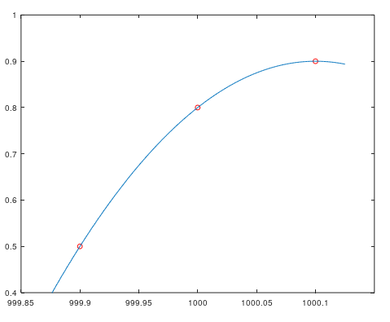
Shifting the x-values
Let us look at an example:
(999.9, 0.5), (1000.0, 0.8), (1000.1, 0.9)
To find the interpolating polynomial at x = 1000.04
The exact answer is y = 0.864

Slide 26
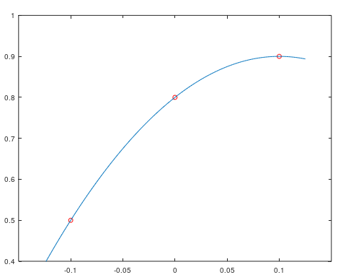
Shifting the x-values
We can solve the system of linear equations
Alternatively, we can use the technique we just described
(–0.1, 0.5), (0, 0.8), (0.1, 0.9)

Slide 27
Shifting the x-values
In Matlab:
>> a = vander( [999.9 1000 1000.1] ) \ [0.5 0.8 0.9]'
a =
-9.999999962993799e+00
2.000199992597534e+04
-1.000199916298154e+07
>> a(1)*1000.04^2 + a(2)*1000.04 + a(3)
ans = 0.8640000019222498
>> quad_interp( 1000.0, 0.1, [0.5 0.8 0.9], 1000.04 )
ans = 0.8639999999999564
The relative error 44056 times larger

Slide 28
Numeric error
Recall that the condition number tells you how much an error may be magnified
>> cond( vander( [999.9 1000 1000.1] ) )
212132567547302.3
>> cond( vander( [-0.1 0.1] ) )
9.999999999999996
The first is larger by a factor of 21 trillion

Slide 29
Other issues
Other issues:
Higher-order interpolating polynomials result in higher error
Consequently, we will restrict ourselves to lower degree interpolating polynomials
If we are interpolating the x-values
x₁ < x₂ < ··· < x_{n}
it is generally only safe to evaluate the interpolating polynomial for values of x₁ < x < x_{n}
If evaluating the interpolating polynomial for values of x either
x < x₁ or x > x_{n}
it is called extrapolation, and the error increases rapidly

Slide 30
Further improvements
Incidentally, here is an improvement to our program:
Map the x-values so that x2 - h, x2 and x2 + h map to -1, 0 and 1, respectively
double quad_interp( double x2, double h, double y[3], double x ) {
double a1{ y[2] - y[0] };
double a2{ y[2] - 2.0*y[1] + y[0] };
double dx{ (x - x2)/h };
return (a2*dx + a1)*dx/2.0 + y[1];
}
This is for information purposes only
- This is not on the examination

Slide 31
Further improvements
Turning it into a class is even more efficient:
class Quad_interp {
public:
Quad_interp( double x2, double h, double y[3] );
double eval( double x ) const;
private:
double a_[3];
double x2_;
double h_;
};
Quad_interp::Quad_interp(double x2, double h, double y[3] ) :
a_{ y[1], (y[2] - y[0])/2.0, (y[2] - 2.0*y[1] + y[0])/2.0 },
x2_{ x2 },
h_{ h } {
// Empty constructor
}
This is for information purposes only
- This is not on the examination

Slide 32
Further improvements
The eval member function only uses the stored coefficients
double Quad_interp::eval( double x ) const {
x = (x - x2_)/h_;
return (a_[2]*x + a_[1])*x + a_[0];
}
This is for information purposes only
- This is not on the examination

Slide 33
Summary
Following this topic, you now
Understand how to find interpolating polynomials using linear algebra
Know the Vandermonde matrix
You also understand why the last column of the matrix is all ones in the Vandermonde matrix
Revisited the justification for using partial pivoting with Gaussian elimination
Understand that large x-values may result in large increases in the error
Are aware of further issues with interpolating polynomials
Have seen some further improvements to our functions

Slide 34
References
[1] https://en.wikipedia.org/wiki/Gaussian_elimination
[2] https://en.wikipedia.org/wiki/Pivot_element
[3] https://en.wikipedia.org/wiki/Jacobi_method
[4] https://en.wikipedia.org/wiki/Condition_number

Slide 35
Acknowledgments
Brian Nguyen for spotting an error in the formula for backward substitution on p.18.
Tazik Shahjahan for pointing out typos.
Aaron Hong for noting the indices on one term of a polynomial were wrong.

Slide 36
Colophon
These slides were prepared using the Cambria typeface. Mathematical equations use Times New Roman, and source code is presented using Consolas. Mathematical equations are prepared in MathType by Design Science, Inc.
Examples may be formulated and checked using Maple by Maplesoft, Inc.
The photographs of flowers and a monarch butter appearing on the title slide and accenting the top of each other slide were taken at the Royal Botanical Gardens in October of 2017 by Douglas Wilhelm Harder. Please see
https://www.rbg.ca/
for more information.

Slide 37
Disclaimer
These slides are provided for the ece 204 Numerical methods course taught at the University of Waterloo. The material in it reflects the author’s best judgment in light of the information available to them at the time of preparation. Any reliance on these course slides by any party for any other purpose are the responsibility of such parties. The authors accept no responsibility for damages, if any, suffered by any party as a result of decisions made or actions based on these course slides for any other purpose than that for which it was intended.

